Slide 1
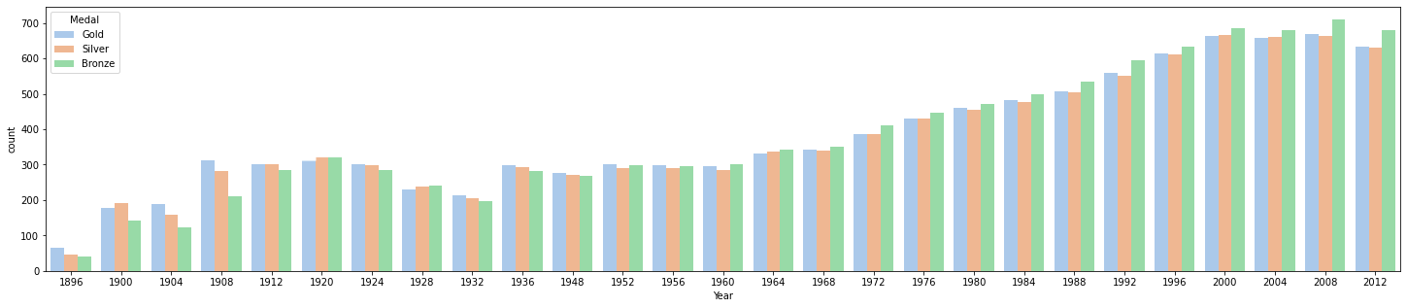

Storytelling with data
Why are the number of medals different every year ?
Why are the three medals different in the same year ?
Notes:
And then, I will introduce additional interesting storytelling with data.
We have generated a histogram based on the data of medals which showing the number of medals produced each year.
We can clearly see that the overall trend in the total number of Olympic medals is increasing year by year.
There are two interesting questions.
First, Why are the number of medals different every year ?
The reason is that the sports of the Olympic are different every year, and the general trend is that more and more sports are opened in the Olympic
Second, Why are the three medals different in the same year ?
The reason is some sports will produce side-by-side first or side-by-side second and third. When two athletes are tied for first place, two gold medals and one bronze are produced.

Slide 2
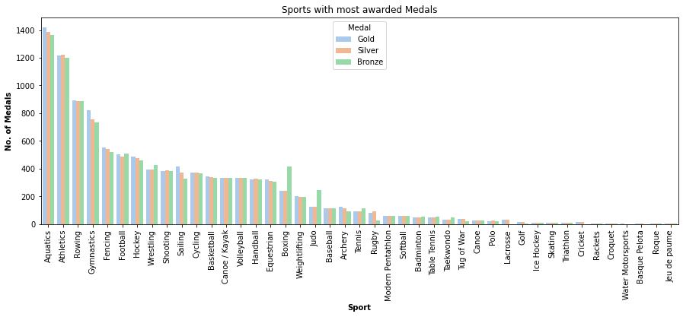
Sports with most awarded medals
Which sports awarded most Medals ?
For boxing and Judo, why the number of Bronze are twice as gold or silver ?
Notes:
We generated a histogram which want to find the sport with most awarded medals, we can clearly see the most medals is Aquatics
After we generated this histogram, we found two interest sports which are boxing and judo,
At first we think they are wrong data, but after we checked them in the internet, we found the real reason:
There are two bronze medals because boxing and judo adopt a single-elimination resurrection competition system. It's interesting.

Slide 3
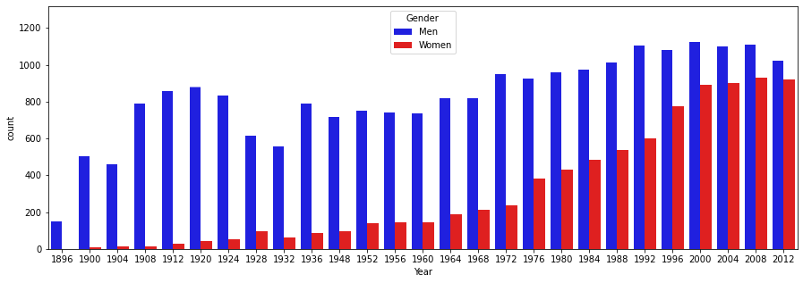
Gender of Olympic
More and more female athletes in the Olympics.
Notes:
We also generated a histogram to show the gender of Olympics
We can clearly see that in eighteen ninety-six, almost no female athletes in the Olympic. But with the progress of the times, more and more female athletes participated in the Olympic.
Maybe in the future, the number of female athletes participating in the Olympics will exceed the number of male athletes.

Slide 4
Thank you for listening
Notes:
Thank you for listening.

